Slide 1
JD+ and R
ESTP Training

Slide 2
Main requirements
RJDemetra
Java runtime (>=11)
R (>= 3.1.1)
rJava (>= 0.9-8)
RJDemetra3
Java runtime (>=17.0)
R (>= 3.6.0)
rJava (>= 1.0-6),
RProtoBuf (>= 0.4.17)

Slide 3
Technical design (Rjdemetra)
Java
R, native
JTsToolkit.jar
Java
jdr.jar
rJava
R
RJDemetra package
Java
SACruncher
R
R-Studio
…
Java
JDemetra GUI

Slide 4
Technical design (Rjdemetra3)
Java
R, native
demetra-xxx.jar
Java
Demetra-xxx-r.jar
rJava,
RProtobuf
R
RJD3xxx package
R
R-Studio
…
Java
JDemetra GUI

Slide 5
Overview
rjd3toolkit
rjd3bench
rjd3modelling
rjd3highfreq
rjd3nowcasting
rjd3sa
rjd3cycle
rjd3tramoseats
rjd3sts
rjd3revisions
rjd3x13
rjd3stl
RJDemetra3
https://github.com/palatej?tab=repositories
Design similar to the Java libraries !

Slide 6

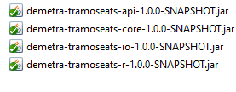
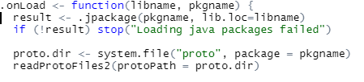
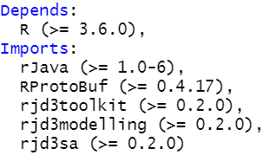
rjd3tramoseats
Proto files
inst
Java package
R files
Description

Slide 7
Objectives of R packages
High-level functions with most common results
Low-level functions
Advanced users
Research
Training

Slide 8
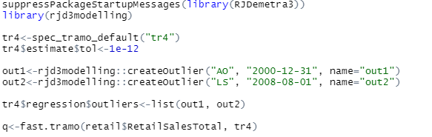
TramoSeats / X13 packages
Specifications
Default specifications
Modifications of the different options (with auxiliary functions)

Slide 9
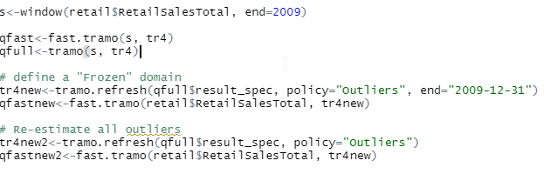
TramoSeats / X13 packages (cont)
Processing
Fast processing (fast.xxx method)
Full processing (xxx.method)
Results
Estimation spec
Result spec
Refreshing of spec

Slide 10
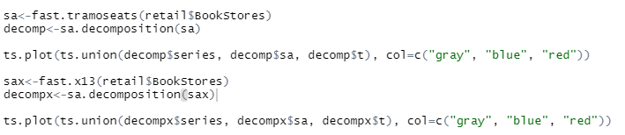
TramoSeats / X13 packages (cont)
Generic functions
TODO
Preprocessing
Diagnostics
…

Slide 11
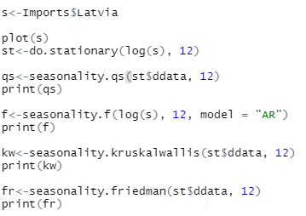

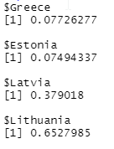
Details. Seasonality tests
Kruskal-Wallis (on stationary series)
Friedman (…)
Qs (…)
Ftest (seasonal dummies)
Combined tests (on S+I)

